Slide 1
Employee Data Analysis using Excel
STUDENT NAME: HARINI.V
REGISTER NO: 470C9D12DB763C6A5FC45AE19A31996D,312208676 DEPARTMENT: B.COM(GENERAL)
COLLEGE: MEENAKSHI COLLEGE FOR WOMEN

Slide 2
PROJECT TITLE
Employee Performance Analysis

Slide 3


AGENDA
Problem Statement
Project Overview
End Users
Our Solution and Proposition
Dataset Description
Modelling Approach
Results and Discussion
Conclusion
3/21/2024 Annual Review

Slide 4

PROBLEM
STATEMENT
The purpose of Employee data analysis helps organizations improve recruitment, performance management, and workforce planning. It enhances employee engagement, ensures fair compensation, supports diversity, and improves training.

Slide 5

PROJECT OVERVIEW
Employee analysis involves it aids in compliance and risk management, leading to better decision-making and overall business performance.

Slide 6

WHO ARE THE END USERS?
HUMAN RESOURCE DEPARTMENTS
MANAGEMENT AND LEADERSHIP
TEAM LEADERS AND SUPERVISORS
EMPLOYEES
EXECUTIVE LEADERSHIP
BUSINESS ANALYSTS
RECRUITERS

Slide 7

OUR SOLUTION AND ITS VALUE PROPOSITION
FILTERING- REMOVE VALUES
PIVOT TABLE - SUMMARY OF EMPLOYEE PERFORMANCE
BAR DIAGRAM - FINAL REPORT

Slide 8
Dataset Description
EMPLOYEE DATA SET- KAGGLE
9 FEATURES IN EXCEL:
Employee id: A unique identifier assigned to each employee
Age: The age of the employee, ranging from 18 to 60 years.
Gender: The gender of the employee
Years at Company: The number of years the employee has been working at the company.
Job Role: The department or role the employee works in, encoded into categories such as Finance, Healthcare, Technology, Education, and Media.
Number of Promotions: The total number of promotions the employee has received.
Distance from Home: The distance between the employee's home and workplace, in miles.
Job Level: The job level of the employee: (Entry, Mid, Senior)
Leadership Opportunities: Whether the employee has leadership opportunities: (Yes or No)
Company Reputation: The employee's perception of the company's reputation: (Very Poor, Poor, Good, Excellent)Employee Recognition: The level of recognition the employee receives:(Very Low, Low, Medium, High)

Slide 9

THE "WOW" IN OUR SOLUTION
By organizing data based on specific criteria, companies can identify trends, address issues like pay disparities or workload imbalances, and make informed decisions to enhance workforce management and productivity
Sorting and filtering employee data allows organizations to analyze performance, attendance, compensation, turnover, and diversity efficiently.
3/21/2024 Annual Re
view
9

Slide 10
MODELLING
STEP -1
DOWNLOAD THE EMPLOYEE DATASET FROM KAGGLE AND OPEN THE EMPLOYEE DATASET IN EXCEL.
STEP -2
SELECT THE ENTIRE DATA AND CLICK ON DATA AND CLICK ON FILTER OPTION.
STEP -3
FILTER FROM A TO Z ORDER.
STEP -4
SELECT THE ENTIRE DATA AND CLICK ON INSERT AND CLICK ON PIVOT TABLE TO CREATE PIVOT TABLE.
10

Slide 11
STEP -5
DRAG THE NEEDED DATA AND CREATE A PIVOT TABLE.
STEP -6
SELECT THE PIVOT TABLE AND CLICK ON INSERT.
STEP-7
NOW CLICK ON THE CHART THAT YOU WANT.
STEP -8
THE CHART IS CREATED.

Slide 12
RESULTS
1.TABLE
Sum of NO. Of departments Performance rating | Column Labels Associate Degree | Bachelor's Degree | High School | Master’s Degree |  | PhD |  | Grand Total
Average | 13 | 7 | 4 | 13 | 4 | 41
Below Average | 4 | 0 | 6 | 7 | 0 | 17
High | 6 | 14 | 4 | 9 | 0 | 33
low | 1 | 0 | 0 | 0 | 0 | 1
Grand Total | 24 | 21 | 14 | 29 | 4 | 92
12

Slide 13
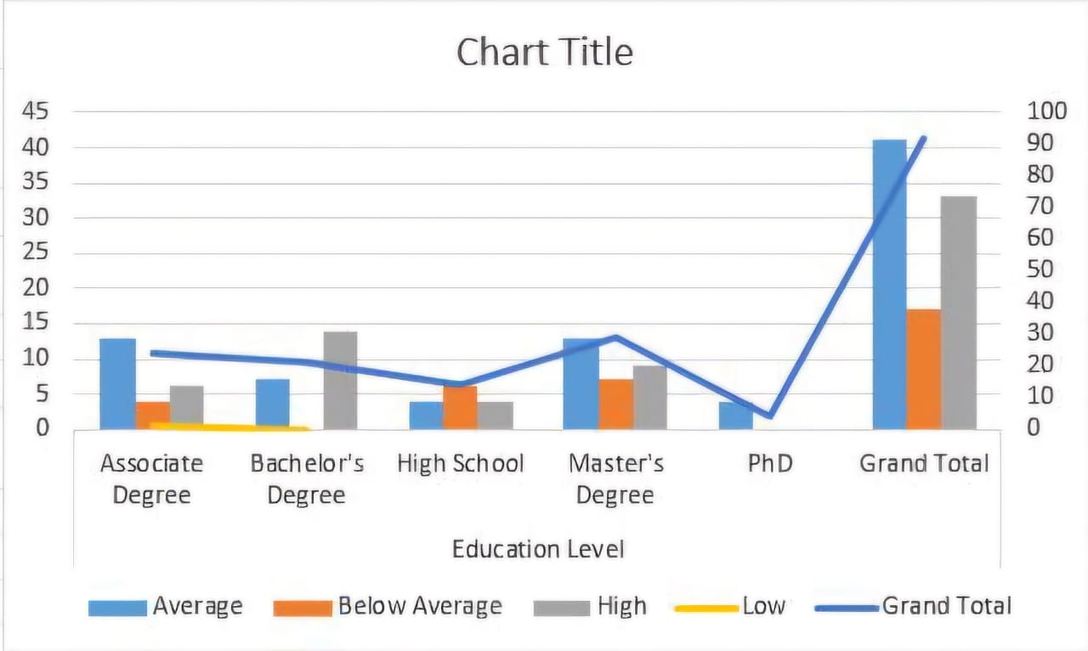
2. BAR DIAGRAM

Slide 14
conclusion
Employee data analysis reveals key insights into workforce trends, performance, and engagement. By leveraging this data, organizations can identify areas for improvement, optimize talent management strategies, and enhance overall productivity.
Effective data analysis helps in making informed decisions, such as targeted training, recruitment strategies, and retention efforts.

